Slide 1

Facebook
BUS 243: Database management
Group 5 | Final Project | MS DA Section 11

Slide 2
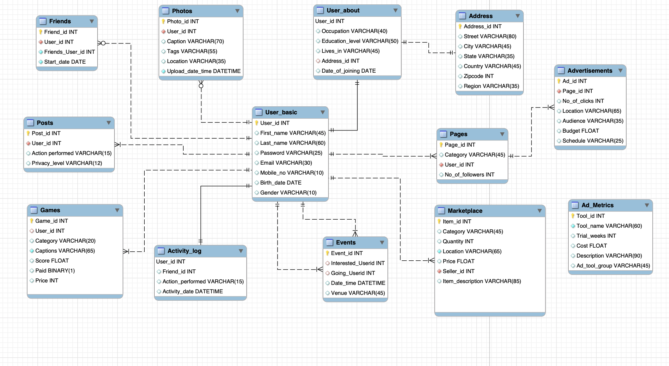
ER D I A G R A M

Slide 3
Goals of the Project
Create tables and entities to accommodate the company’s data.
Perform routine activities such as adding a new friend, displaying friend list and so on.
Predict user preferences and provide recommended links. This will enable us to personalize the Newsfeed for the user based on his/her likes/interests.
Delete any reported user or shadow profile from the system.
View and count the number of invitees and participants to an event.
Sort games to show free and least expensive games. Sort products and filter contents in Fb marketplace
Enable user to view the advertisement package details and data analytics tools.

Slide 4
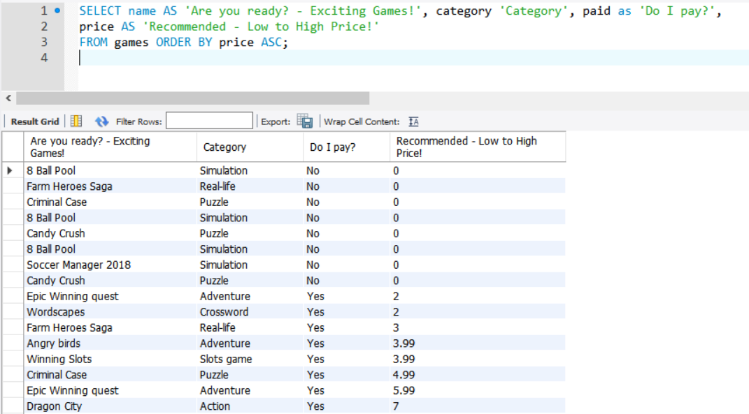
Recommend least expensive games
Command:
SELECT name AS ' Are you ready? - Exciting games!', category 'Category', paid as 'Do I pay?', price AS 'Recommended - Low to High Price!' FROM games ORDER BY price ASC;

Slide 5
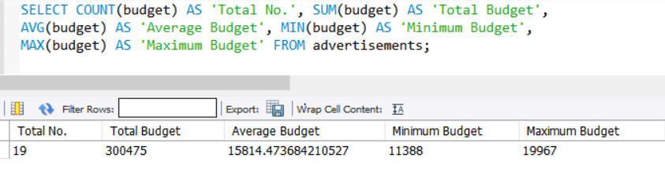
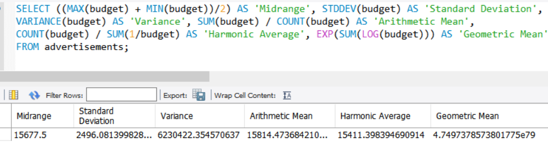
Descriptive analysis
Commands: SELECT COUNT(budget) AS 'Total No.’, SUM(budget) AS 'Total Budget’, AVG(budget) AS 'Average Budget’, MIN(budget) AS 'Minimum’, MAX(budget) AS 'Maximum Bdget’ FROM advertisements;
SELECT ((MAX(budget) + MIN(budget))/2) AS 'Midrange’, STDDEV(budget) AS 'Standard Deviation', VARIANCE(budget) AS 'Variance’, SUM(budget) / COUNT(budget) AS 'Arithmetic Mean’, COUNT(budget) / SUM(1/budget) AS 'Harmonic Average’, EXP(SUM(LOG(budget))) AS 'Geometric Mean’ FROM advertisements;

Slide 6
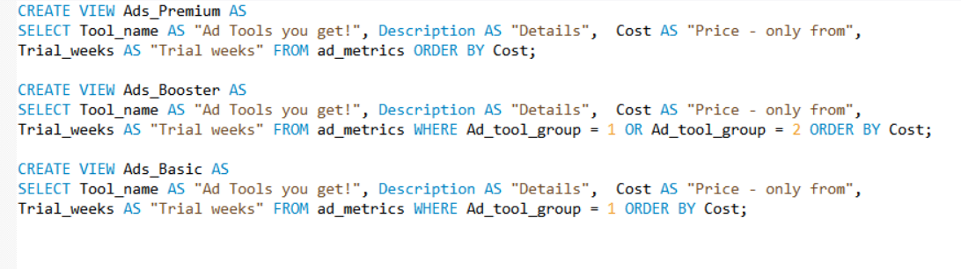
Views for Ads Plan
Commands:
CREATE VIEW Ads_Premium ASSELECT Tool_name AS "Ad Tools you get!", Description AS "Details", Cost AS "Price - only from",Trial_weeks AS "Trial weeks" FROM ad_metrics ORDER BY Cost;
CREATE VIEW Ads_Booster ASSELECT Tool_name AS "Ad Tools you get!", Description AS "Details", Cost AS "Price - only from",Trial_weeks AS "Trial weeks" FROM ad_metrics WHERE Ad_tool_group = 1 OR Ad_tool_group = 2 ORDER BY Cost;
CREATE VIEW Ads_Basic ASSELECT Tool_name AS "Ad Tools you get!", Description AS "Details", Cost AS "Price - only from",Trial_weeks AS "Trial weeks" FROM ad_metrics WHERE Ad_tool_group = 1 ORDER BY Cost;

Slide 7
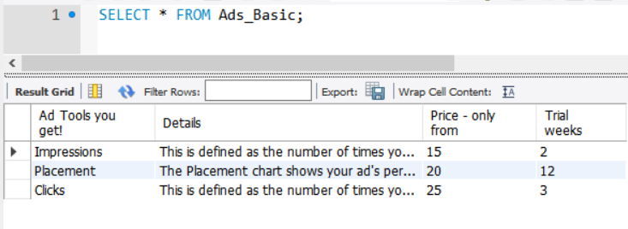
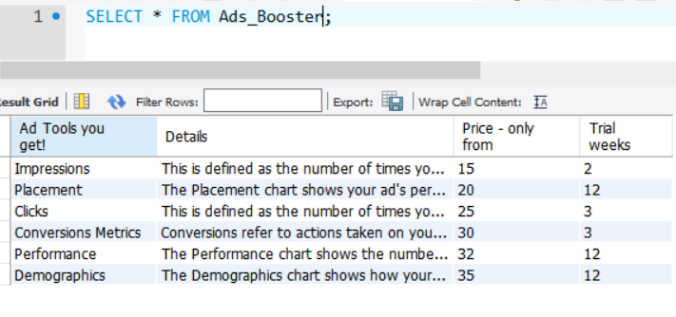
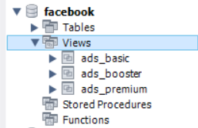
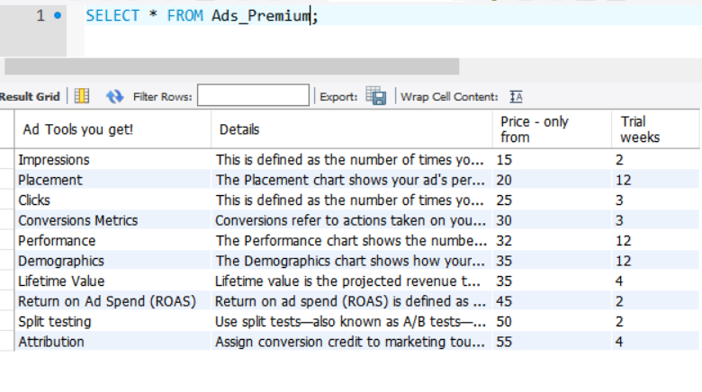
View the views with DA Toolkit for each Ad plan
Command:
SELECT * FROM Ads_Basic;
Commands:
SELECT * FROM Ads_Booster;
SELECT * FROM Ads_Premium;

Slide 8
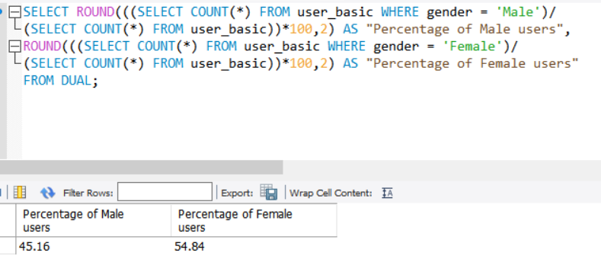
Demographic Analysis Gender-based study Using DUAL table
Commands:
SELECT ROUND(((SELECT COUNT(*) FROM user_basic WHERE gender = 'Male’) /(SELECT COUNT(*) FROM user_basic))*100,2) AS "Percentage of Male users",
ROUND(((SELECT COUNT(*) FROM user_basic WHERE gender = 'Female')/(SELECT COUNT(*) FROM user_basic))*100,2) AS "Percentage of Female users“
FROM DUAL;

Slide 9
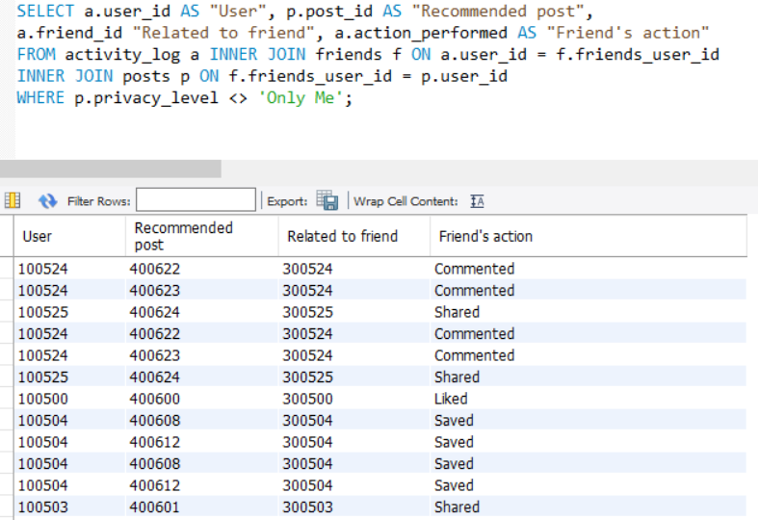
Recommended posts on NewsFeed Predicting interest by using three tables and INNER JOIN based on friend’s activities.
Commands:
SELECT a.user_id AS "User", p.post_id AS "Recommended post", a.friend_id AS "Related to friend", a.action_performed AS "Friend's action” FROM activity_log a INNER JOIN friends f ON a.user_id = f.friends_user_id INNER JOIN posts p ON f.friends_user_id = p.user_id WHERE p.privacy_level <> 'Only Me';

Slide 10
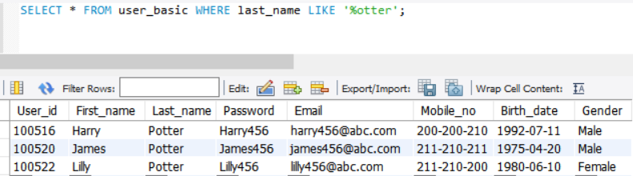
Fun question! FBI asks for a list of users with name ending in ‘otter’, how do we query the database?
Command:
SELECT * FROM user_basic WHERE last_name LIKE '%otter';

Slide 11
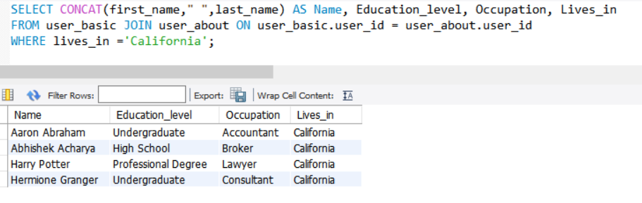
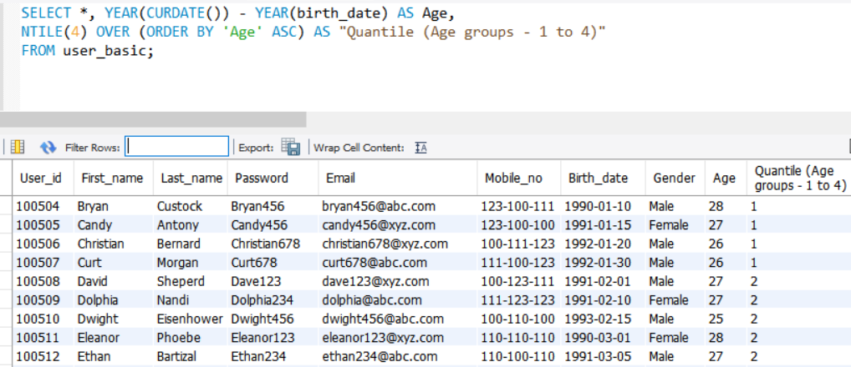
Demographic Analysis 2.0 Background study of California residents using JOIN_ON clause & Age groups using Age as a derived attribute & NTILE function
Commands:
SELECT CONCAT(first_name," ",last_name) AS Name, Education_level, Occupation, Lives_inFROM user_basic JOIN user_about ON user_basic.user_id = user_about.user_id WHERE lives_in ='California’;
SELECT *, YEAR(CURDATE()) - YEAR(birth_date) AS Age, NTILE(4) OVER (ORDER BY 'Age' ASC) AS "Quantile (Age groups - 1 to 4)“ FROM user_basic;

Slide 12
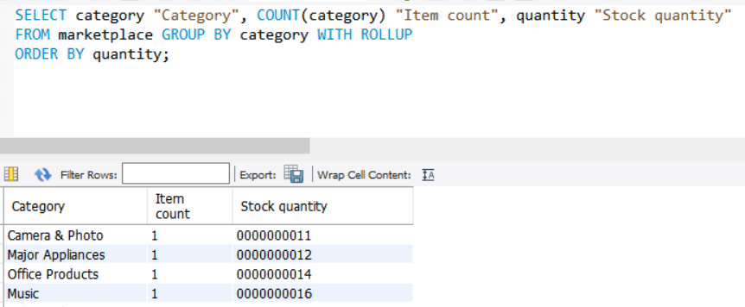
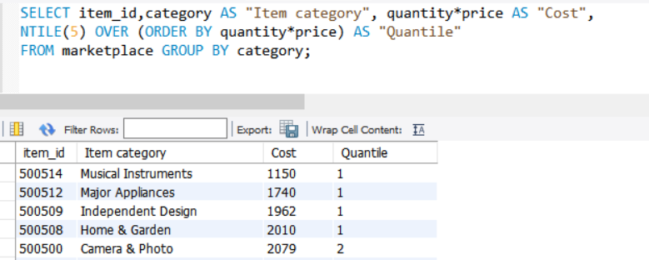
Fb Marketplace study Aggregation with ROLLUP and NTILE functions
Commands:
SELECT category "Category", COUNT(category) "Item count", quantity "Stock quantity“
FROM marketplace GROUP BY category WITH ROLLUPORDER BY quantity;
SELECT item_id,category AS "Item category", quantity*price AS "Cost", NTILE(5) OVER (ORDER BY quantity*price) AS "Quantile" FROM marketplace GROUP BY category;

Slide 13
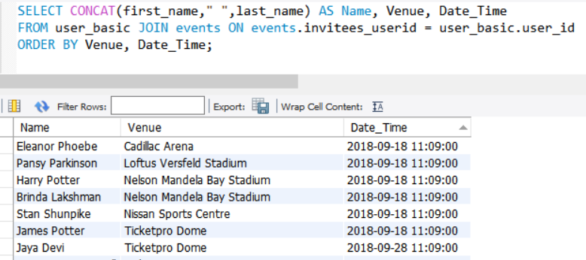
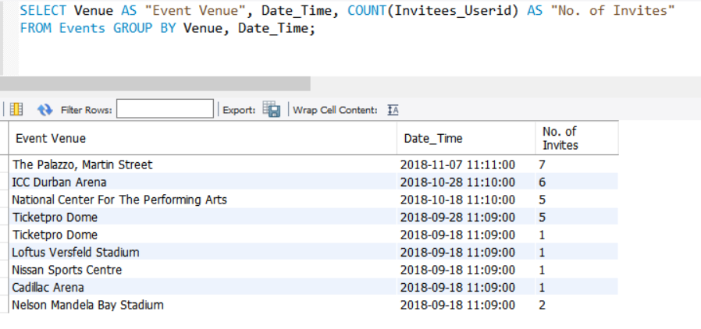
Events in Fb Count of invites and Name of invitees using COUNT, GROUP_BY, JOIN and CONCAT functions
Commands:
SELECT CONCAT(first_name," ",last_name) AS Name, Venue, Date_Time FROM user_basic JOIN events ON events.invitees_userid = user_basic.user_id ORDER BY Venue, Date_Time;
SELECT Venue AS "Event Venue", Date_Time, COUNT(Invitees_Userid) AS "No. of Invites" FROM Events GROUP BY Venue, Date_Time;

Slide 14
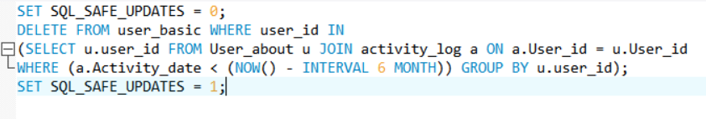

Delete reported users and shadow / inactive profiles without compromising referential integrity Using DELETE, JOIN_ON, INTERVAL 6 MONTH and NOW function
Commands:
DELETE FROM user_basic WHERE user_id = 100528;
SET SQL_SAFE_UPDATES = 0;
DELETE FROM user_basic WHERE user_id IN
(SELECT u.user_id FROM User_about u JOIN activity_log a ON a.User_id = u.User_id
WHERE (a.Activity_date < (NOW() - INTERVAL 6 MONTH)) GROUP BY u.user_id);
SET SQL_SAFE_UPDATES = 1;

Slide 15
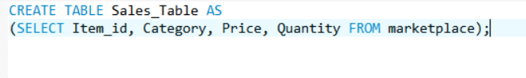
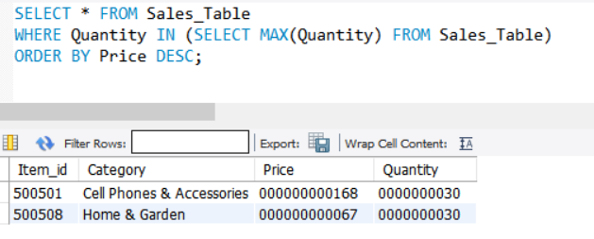
Routine miscellaneous tasks
Commands:
CREATE TABLE Sales_Table AS (SELECT Item_id, Category, Price, Quantity FROM marketplace);
SELECT * FROM Sales_Table WHERE Quantity = (SELECT MAX(Quantity) FROM Sales_Table) ORDER BY Price DESC;

Slide 16

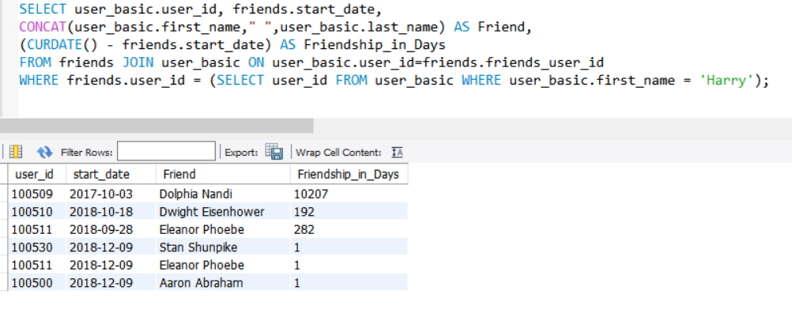
Simple delightful final task! Adding friends using INSERT and determining the friends list of a user named “Harry” and duration of friendship using JOIN_ON clause
Commands:
INSERT INTO friends VALUES (300629, 100516, 100530, '2018-12-09’),
(300630, 100516, 100511, '2018-12-09'), (300631, 100516, 100500, '2018-12-09’);
SELECT user_basic.user_id, friends.start_date, CONCAT(user_basic.first_name," ",user_basic.last_name) AS Friend, (CURDATE() - friends.start_date) AS Friendship_in_Days FROM friends JOIN user_basic ON user_basic.user_id=friends.friends_user_id WHERE friends.user_id = (SELECT user_id FROM user_basic WHERE user_basic.first_name = 'Harry’);

Slide 17
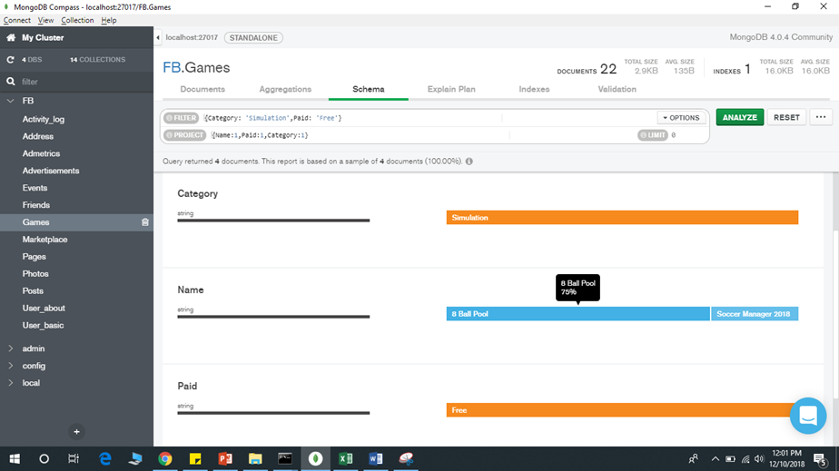
Mongo DB Analysis of Games Of the games which are free under the simulation category - Most people prefer to play 8 Ball Pool (75%) – using the Analyze Schemas feature in MongoDB.

Slide 18
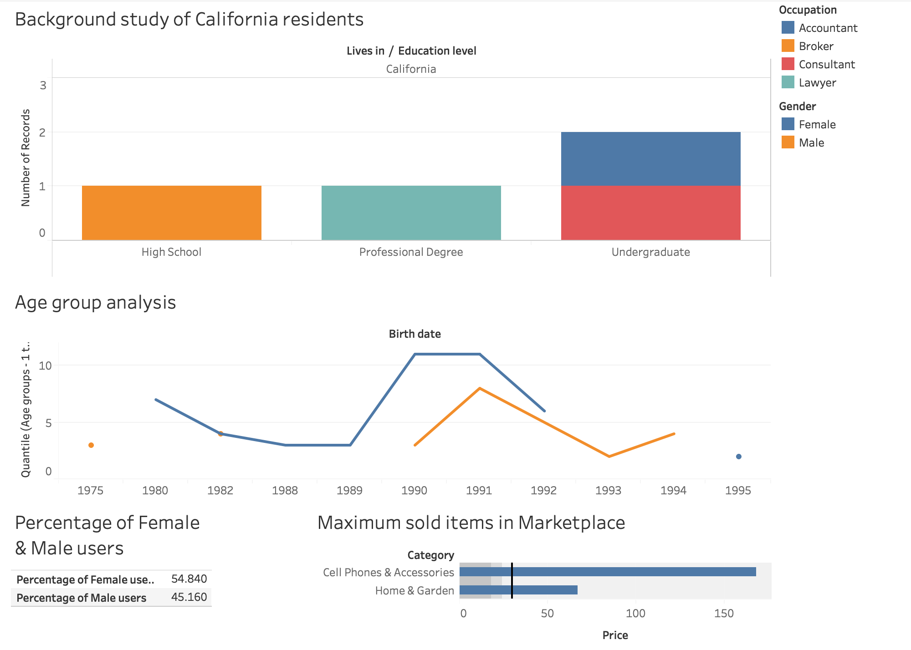
Tableau

Slide 19
Conclusion
Starting with identifying entities, relationships and designing an ER diagram, we forward engineered to create this small replica of Facebook database. Fictitious data was created for this purpose in an excel sheet, before importing the same to the MySQL workbench.
Below is the marked checklist of goals pursued during this project. Create tables and entities to accommodate the company’s data.
Perform routine activities such as adding a new friend, displaying friend list and so on.
Predict user preferences and provide recommended links. This will enable us to personalize the Newsfeed for the user based on his/her likes/interests.
Delete any reported user or shadow profile from the system.
View and count the number of invitees and participants to an event.
Sort games to show free and least expensive games. Sort products and filter contents in Fb marketplace
Enable user to view the advertisement package details and data analytics tools.
Tick mark represents a completed task. All the goals were accomplished successfully.
We explored the data in tableau to study it’s properties and additionally, performed descriptive and demographic analysis of the dataset at hand.

Slide 20
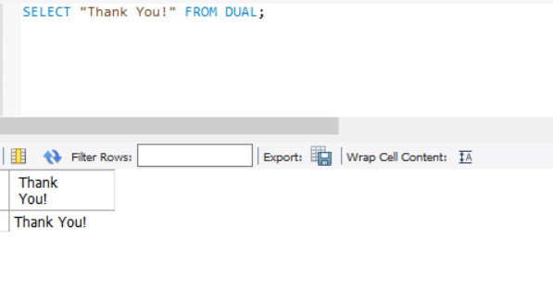
Team Members: Megha Rajam Rao (Id: 013709488) Rajasree Rajendran (Id: 013774358) Sai Chaitanya Tolem (Id: 013008788)
Thank you!

